Slide 1

MOVIE
RECOMMENDATION SYSTEM
BY MOHAMED SHABEEB

Slide 2

1
Hello,
2
3
4
I’m Mohamed Shabeeb
5
Data Science Enthusiast
6
Proactive BSc (Hons) Software Engineering undergraduate at Sabaragamuwa University of Sri Lanka, with a strong passion for data science, data engineering, and ETL processes. I possess a solid foundation in software development and have a keen interest in analyzing and solving complex problems. Eager to leverage my skills in both software development and data science to address real-world challenges and drive innovation in the tech industry. Currently seeking internship opportunities in data-related roles, including data analysis, engineering, and ETL, to learn, grow, and contribute effectively within a dynamic team.
7
8
9

Slide 3



1
MODEL SELECTION
2
3
CONTENT-BASED FILTERING
Content-Based Filtering was utilized to recommend movies based on their content, particularly focusing on attributes such as genre and overview. The system employs cosine similarity between movie descriptions to identify and suggest similar movies to the user.
4
5
6
ITEM-BASED COLLABORATIVE FILTERING
Item-based Collaborative Filtering focuses on finding similar movies instead of similar users to recommend based on their past preferences. It identifies pairs of movies rated by the same users, measures their similarity across all users who rated both, and then recommends similar films based on the similarity scores.
7
8
9

Slide 4


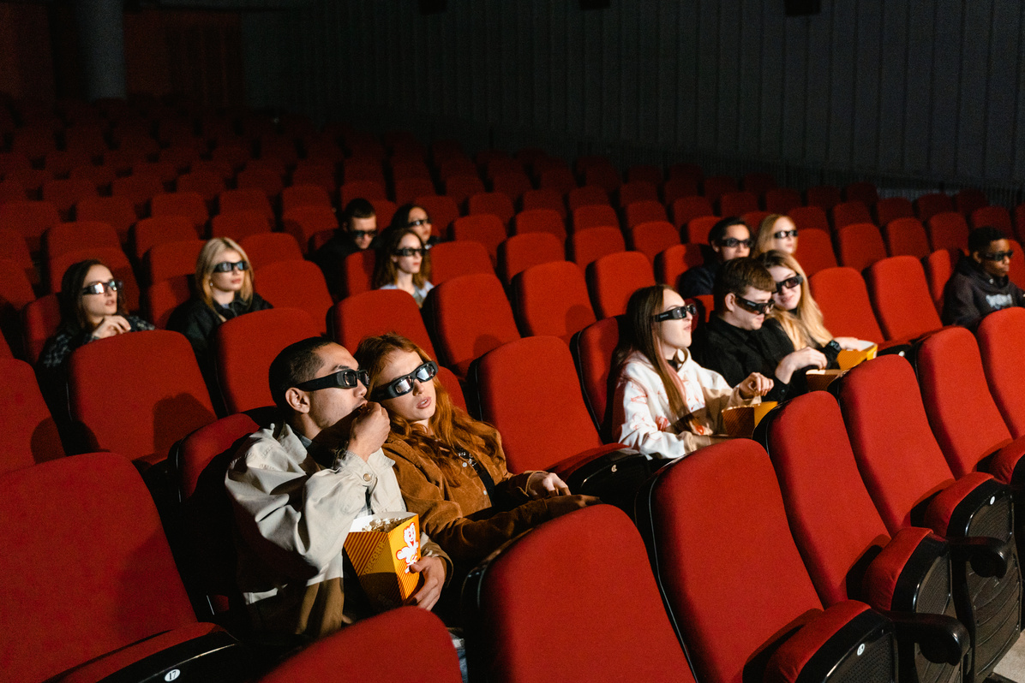
CONTENT-BASED FILTERING
1
2
Data Preprocessing: Overview and genre columns were merged into a 'tags' column for content-based filtering. Text preprocessing included lowercase conversion, punctuation removal, stopword elimination, and lemmatization.
Vectorization: CountVectorizer was applied to the cleaned tags_clean column to convert the textual data into a matrix of token counts. This transformation enabled the system to represent each movie as a vector of word occurrences.
Cosine Similarity: To measure the similarity between movies, the cosine similarity technique was used. It calculates the cosine of the angle between two vectors in the multidimensional space, where smaller angles which means larger cosine values indicate higher similarity.
Recommendation Function: A recommendation function was defined to find similar movies by locating the movie index, computing cosine similarity, sorting by similarity, and returning the top five matches.
Model Serialization: After training, the new_data DataFrame and similarity matrix were serialized using pickle to save the model and similarity data for future use.
Model Deploymment: movies_list.pkl file containing movie data and the similarity.pkl file containing the similarity matrix were loaded using pickle to make real-time recommendations.
3
4
5
6
7
8
9

Slide 5
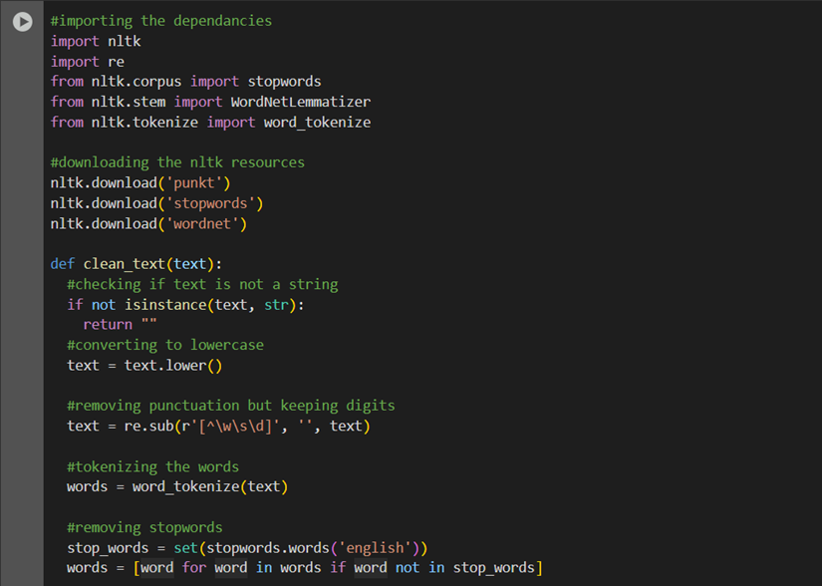
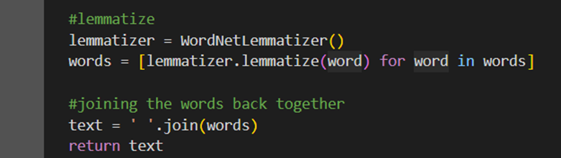
1
2
3
4
5
6
7
8
9
Cleaning Text by Lowercasing, Removing Punctuation and Stopwords, Tokenizing, Lemmatizing, and Rejoining Words for Analysis.

Slide 6
1
2
3
4
5
6
Vectorizing
7
8
9

Slide 7
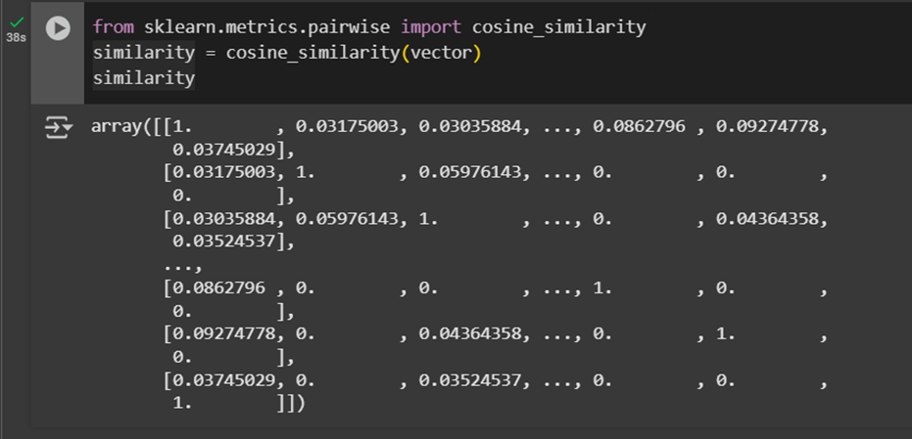
1
2
3
4
5
6
7
8
9
Calculating the Cosine Similarity Between all Vectors in the Dataset

Slide 8
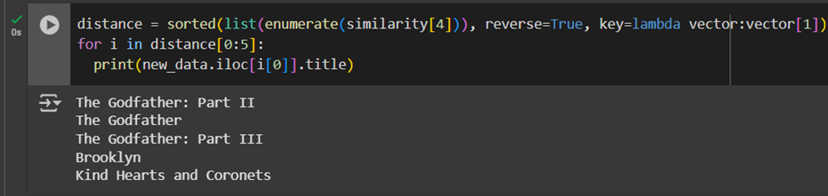
1
2
3
4
5
6
7
8
Finding and Printing the Titles of the Top 05 Most Similar Movies to the One at Index 04
9

Slide 9
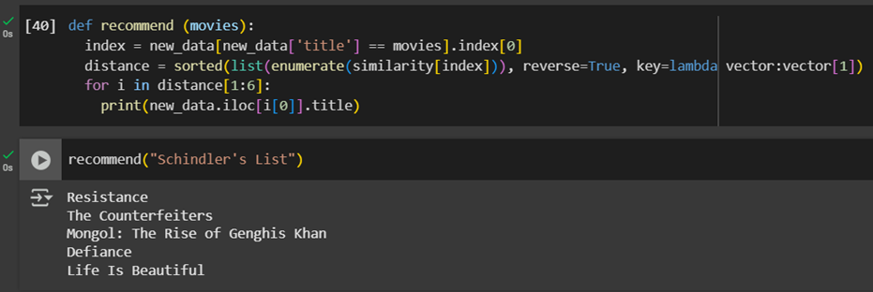
1
2
3
4
5
6
7
8
Defining a Recommend Function to Find and Print the Top 05 Similar Movies to a Given Title.
9

Slide 10
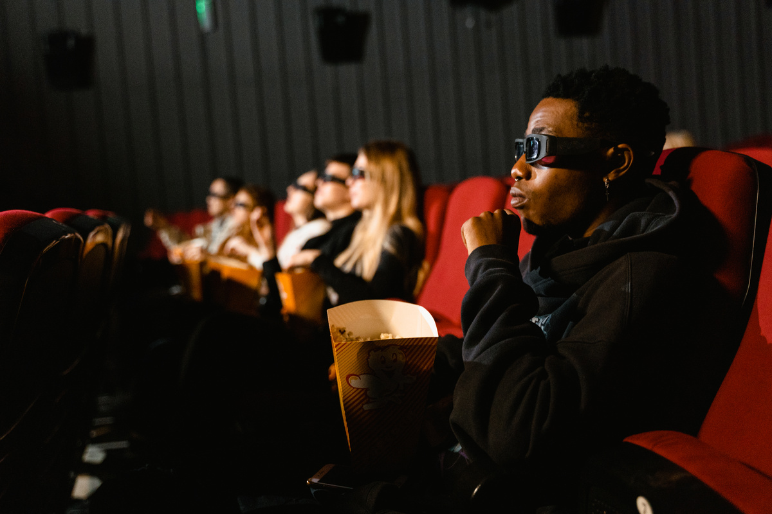



COLLABORATIVE FILTERING
1
2
Preparing the User-Item Interaction Matrix: Collaborative filtering relies on past user interactions rather than movie content. I used a dataset containing user ratings and transformed it into a user-item matrix, where: rows represent movies, columns represent user Id and values represent ratings given by users to movies.
Optimizing the Data for Faster Computation: To reduce memory usage and improve performance, we convert the user-item matrix into a Compressed Sparse Row (CSR) matrix using the scipy library. This format efficiently stores only nonzero values, making similarity computations faster.
Finding Similar Movies Using Nearest Neighbors (KNN): I applied the K-Nearest Neighbors (KNN) algorithm with cosine similarity as the distance metric. KNN clusters movies based on user rating patterns, identifying movies that are frequently rated together.
Making Movie Recommendations: To generate recommendations, I located the selected movie in the similarity matrix, retrieved movies with the highest similarity scores, ranked the similar movies and returned the top recommendations. Finally, the system was tested by querying different movie titles and validating whether the suggested movies align with expected genres and themes.
3
4
5
6
7
8
9

Slide 11
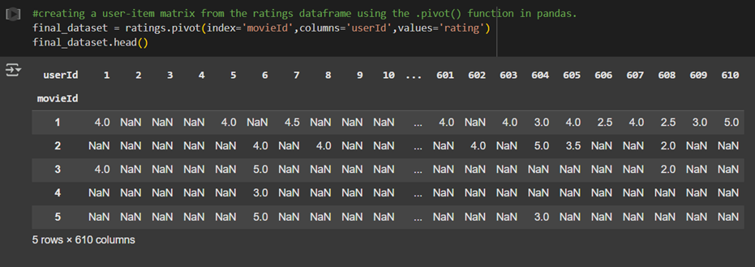
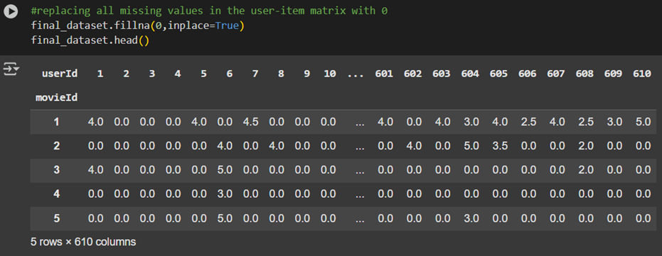
1
2
3
4
5
6
7
8
9
Creating a User-Item Matrix from the Ratings Dataframe and Replacing the Missing Values with 0

Slide 12
1
2
3
4
5
6
7
Converting the final_dataset to a Sparse CSR Matrix and Resetting the Dataframe's Index.
8
9

Slide 13
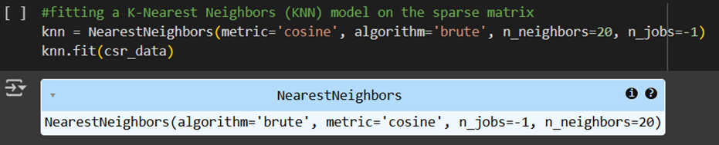
1
2
3
4
5
6
7
8
Fitting a K-Nearest Neighbors (KNN) Model on the Sparse Matrix
9

Slide 14
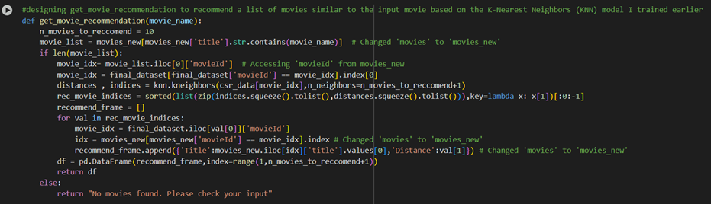
1
2
3
4
5
6
7
8
Creating get_movie_recommendation to Recommend Movies Similar to the Input Movie Based on the
K-Nearest Neighbors (KNN) Model Trained Earlier
9

Slide 15
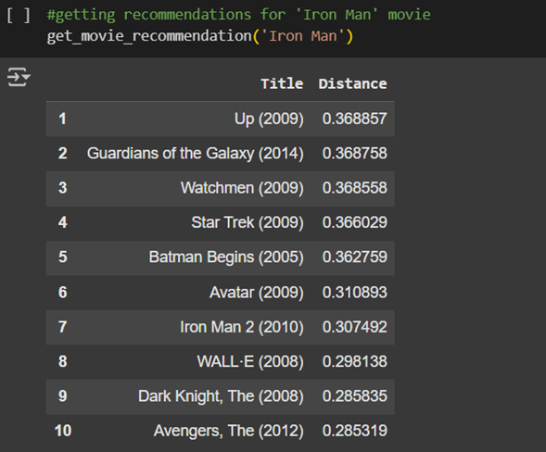
1
2
3
4
5
6
7
8
9
Getting the Recommendations for the "Iron Man" Movie

Slide 16
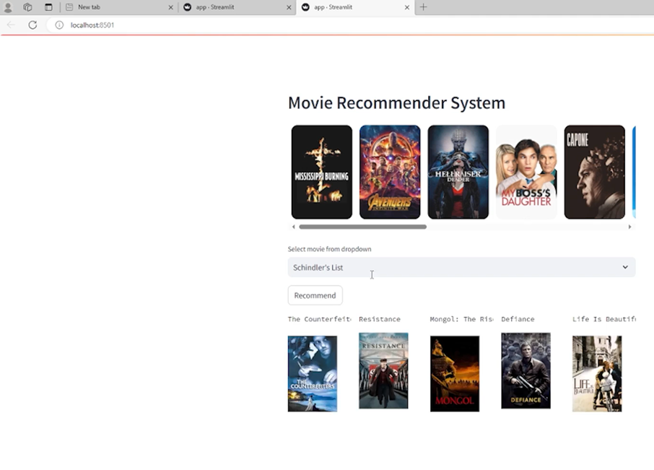
MODEL DEVELOPMENT
1
2
To provide an interactive and user-friendly experience, Streamlit was used to develop the UI for the movie recommendation system.
Streamlit is a powerful Python framework that enables the creation of web applications with minimal effort. The application was deployed locally using localhost, allowing users to input a movie title and receive personalized recommendations in real time.
The user interface was designed to be simple yet effective, displaying the recommended movies dynamically based on content-based filtering and item-based collaborative filtering.
The backend, integrated with the preprocessed movie data and similarity matrix, ensures seamless interaction between user input and the recommendation engine.
This approach allows for quick testing, iteration, and deployment while maintaining an intuitive interface for users.
3
4
5
6
7
8
9

Slide 17
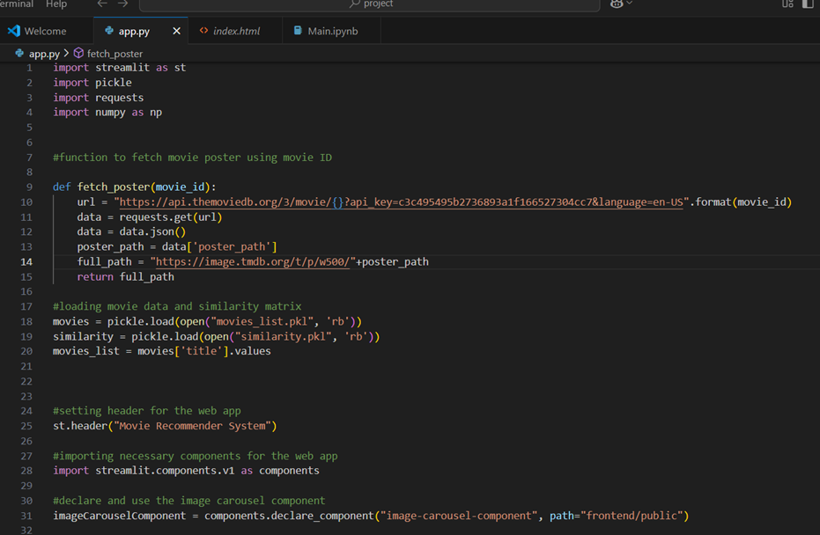
1
2
3
4
5
6
7
8
9
app.py [1]

Slide 18
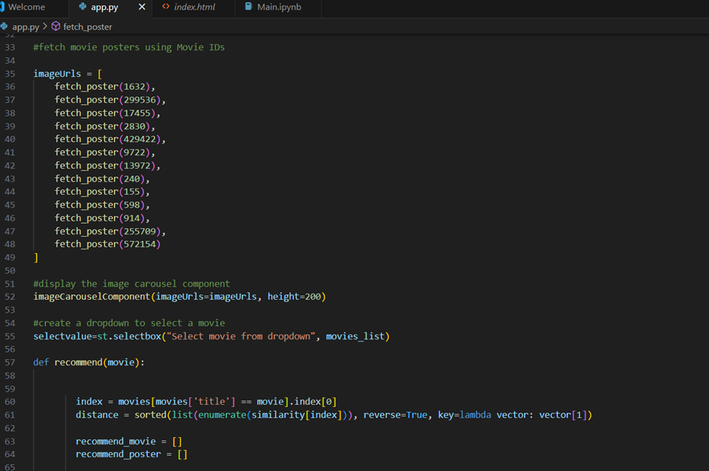
1
2
3
4
5
6
7
8
9
app.py [2]

Slide 19
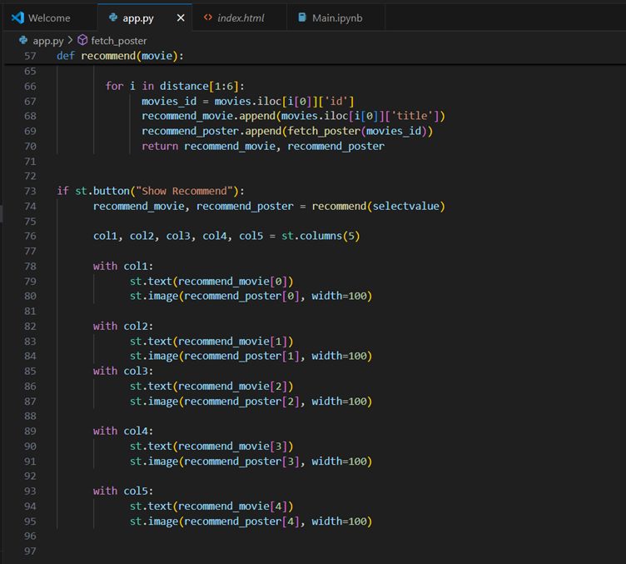
1
2
3
4
5
6
7
8
9
app.py [3]

Slide 20




TECH STACK
1
2
Models: Content-Based Filtering & Item-Based Collaborative Filtering
Tools: VS Code, Google Collab
Dataset: Kaggle.com
Frontend Implementation: Streamlit
Language: Python 3.13.1
Python Libraries & Modules: Pandas, Numpy, NLTK, Scikit-Learn, Pickle, SciPy, Csr_Matrix
Hosting: Localhost
API: TMDb (The Movie Database) API
3
4
5
6
7
8
9

Slide 21

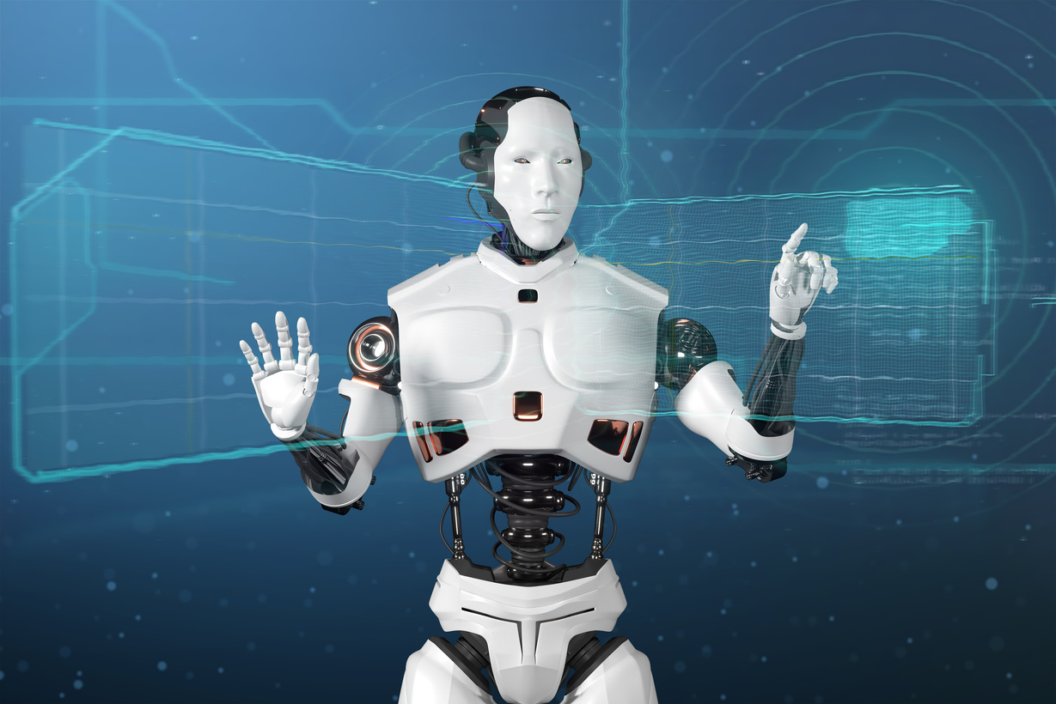

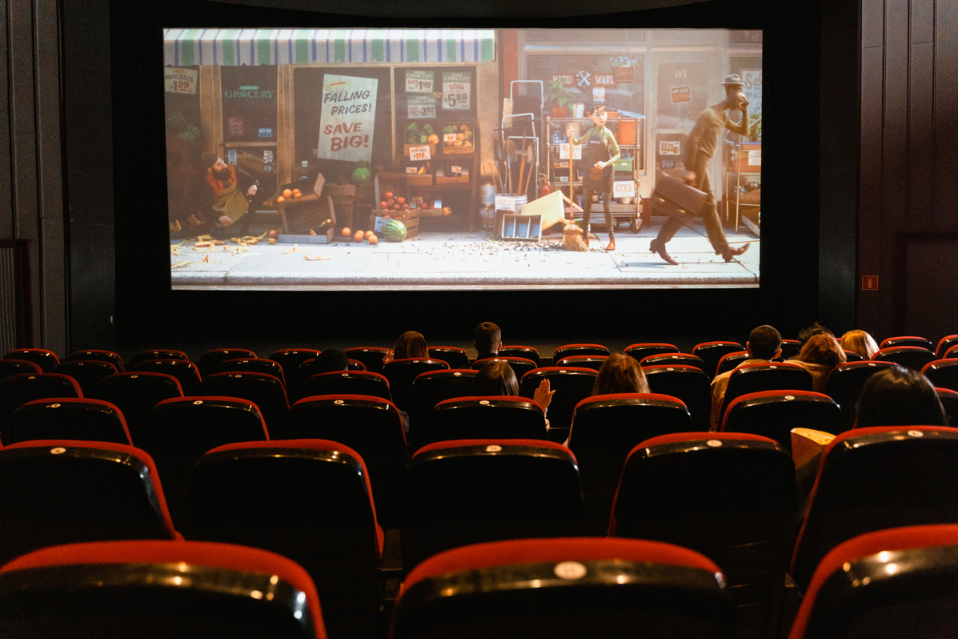
FUTURE WORKS
1
2
Incorporating More Features for Recommendation: Currently, the system relies on genre and overview for recommendations. Other attributes, such as director, cast, release year, and user ratings, can be integrated to enhance the recommendation quality. Integrating user preferences or feedback through ratings can refine suggestions by personalizing the recommendations.
Visualizing Recommendations: Enhance the user interface in Streamlit by displaying additional information about recommended movies, such as movie posters, rating statistics, synopsis, and even trailer previews. o Implement interactive elements like allowing users to filter recommendations by genre, release date, or rating.
Real-Time Personalization: Incorporating user preferences into the recommendation system through user profiles and user-item interactions (e.g., click-through rate, watch history) could make the system more personalized. AllowIng users to rate or "like" movies, which could be incorporated to refine the recommendations.
3
4
5
6
7
8
9

Slide 22
THANK YOU

